Slide 1
RTP: Adapting the model
For mood and psychotic disorders

Slide 2
Outline
Overview: What does mentorship currently look like at the MUHC mental health mission?
The RTPublication
Adaptation of model based on unique needs
Meeting the mentors
Questions and discussion: Future collaborations?

Slide 3
Notes:
RTP volunteers are patients, family members, current and retired clinical staff and students
Following a one-year commitment to mentoring, Peer Mentors transition into management roles within the RTP that include chairing committees, training and supervision of new Peer Mentors, management of web site, maintaining ongoing program evaluation
and delivery of program dissemination to other MUHC units and other mental health care sites

Slide 4
RTP PEER MENTORS
First Cohort (2016-2017)
Angie
Bernie
Cecelia
Danielle
Francine
Julia
Matthew
Michael
Rafael
Second Cohort
(2017-2018)
Affrica
Betty
Cami
Chan
Cindy
Imogen
Jeff
Saya
Third Cohort
(2018-2019)
Debra
Gaaya
Jacob
Jessica
Joe
Massimo
Natalie
Robin
Stephanie
Tara
Terry
Vince
Notes:
29 Peer Mentors in three cohorts have successfully completed the training course and have mentored more than 100 patients referred by HCP’s from the AMI & GEC
Many remain active members of the RTP, for example…

Slide 5
Peer Mentor Training Course
Intensive 30-hour peer led training course followed by 20-hours of practicum and on-going weekly supervision
Topics include:
peer mentor roles
confidentiality
communication and listening skills
boundaries and self-disclosure
dealing with crisis and difficult situations
self-care
Notes:
The 3rd cohort have recently completed the intensive 30-hour peer led training course
Topics include: (review slide)
Weekly Supervision meetings are well attended by peer mentors who are actively mentoring and guided by more experienced mentors;
Ongoing training is provided with presentations on topics that include community resources and communication skills

Slide 6
Peer Mentors collaborate with clinical teams
GEC Wellness and Day Program – Peer mentors integrated into existing programs, co-facilitating with staff
AMI Early Psychosis Group – Peer mentors were integrated into an existing group, facilitated by staff
AMI CBT Group for Depression - peer mentors are invited to share their experience recovering from mental illness with patients attending the group
AMI Day Hospital - Peer Mentors are invited to attend the Community Links and Discharge groups to share their experience transitioning from institutional care to the community
Family Discussion Groups – Peer mentors collaborated with clinical staff to deliver family/caregiver discussion groups
Notes:
Peer Mentors have been collaborating with clinical teams
They have been integrating into existing programs, organized discussion groups, and are regularly invited to share their experience of recovery with groups in the Day Program at the GEH, and the Community Links and Discharge groups at the Day Hospital

Slide 7
Peer Mentors design and co-facilitate workshops
Cultivating Spirituality – 4-session workshop designed by a peer mentor, co-facilitated by a 3-member peer mentor team in the Day Hospital at the AMI and in the Day Program at the GEC; supervised by staff
Rediscovering Your Sober Self – two 6-session workshops delivered for patients the addictions unit at the GEC
Art Workshops - workshops designed and facilitated by peer mentors have run at the AMI and GEC
WRAP Training – for Peer Mentors to facilitate workshops to support peers in developing self-management skills
Notes:
Peer Mentors have also been collaborating with clinical teams to design and facilitate workshops for the RTP
Francine with Kathryn Gill co-designed and facilitated two 6-week workshops at the Griffith Edwards Centre
We have been in discussion with Dr. Lowe and some of her students about training mentors to facilitate WRAP workshops where mentors will support their peers in developing self-management skills.
All RTP workshops are evaluated using exit surveys.
Staff at the MUHC will be surveyed in the next phase of the program evaluation.

Slide 8
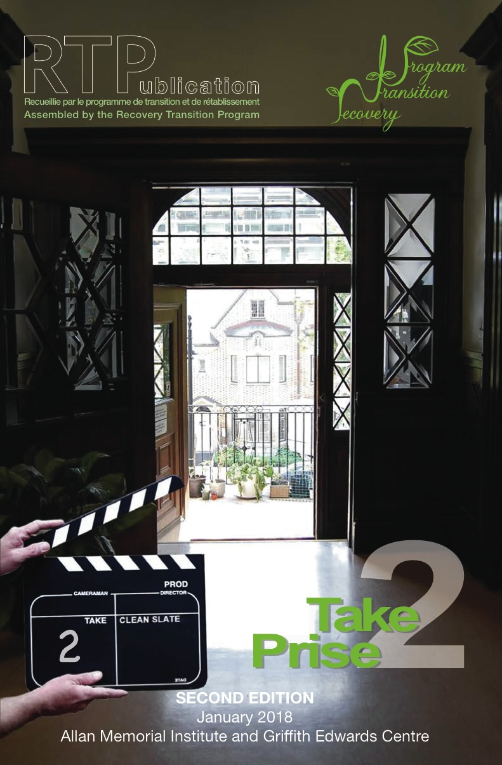

RTPublication
Notes:
RTPublication was created by volunteers, with the support of clinical staff.
It explores the experience of recovery from mental illness and addiction through poetry, art, articles and stories with the hope that others will feel less alone
The first edition focused on the RTP, it’s volunteers and activities
The second looked at the people and services at the GEC
The most recent zine explored the Day Hospital
In the forth edition we hope to better understand STS and early psychosis
A digital version of the zine is on the RTP website
The zine team meet once a week in the RTP Conference Room at the AMI
Please let us know of any patients that may be interested in joining the zine team workshop, or submitting their work for publication

Slide 9
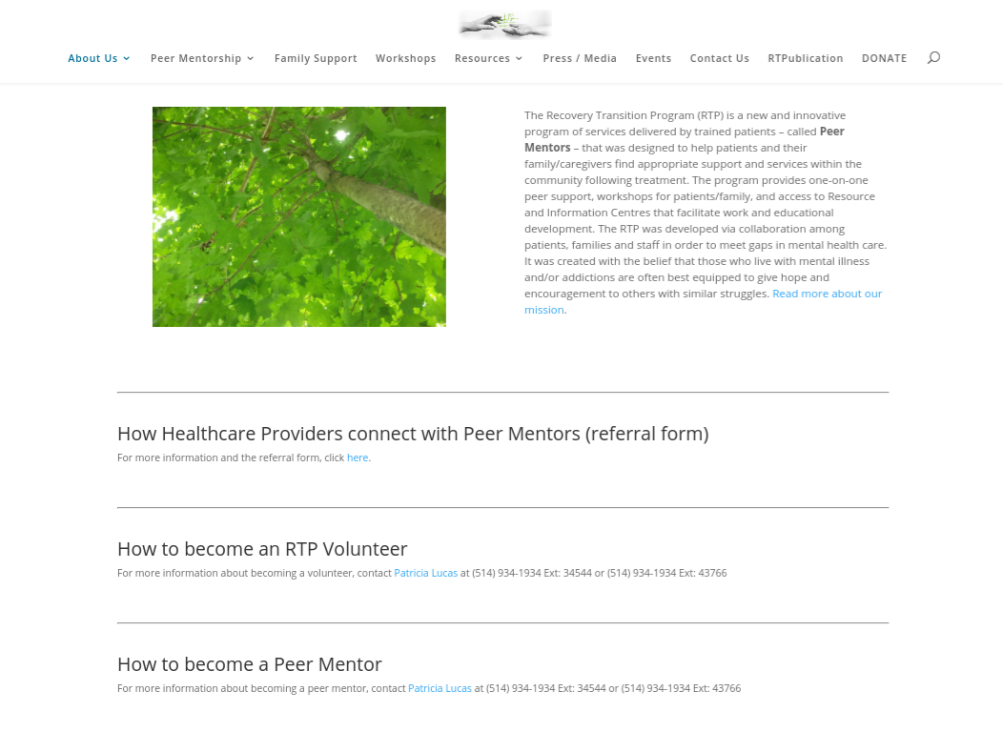
www.recoverytransitionprogram.com
Notes:
The RTP website has an extensive community resources page.
Please take a look, and let us know if there are resources that you’d suggest that we include
You may also learn more about the RTP, and how to refer patients for mentoring.

Slide 10
Adaptation of model
Mentors working alongside staff: in groups, clinical encounters, family education
Consultation and education of staff

Slide 11


Slide 12

Discussion: future collaboration

